Slide 1
Computer Organization and Architecture
Topic :Performance

Slide 2
Performance Perspectives
Purchasing perspective
Given a collection of machines, which has the
Best performance ?
Least cost ?
Best performance / cost ?
Design perspective
Faced with design options, which has the
Best performance improvement ?
Least cost ?
Best performance / cost ?
Both require
basis for comparison
metric for evaluation
Our goal: understand cost & performance implications of architectural choices

Slide 3
Defining Performance
§1.6 Performance
Which airplane has the best performance?

Slide 4
Response Time and Throughput
Response time
How long it takes to do a task
Throughput
Total work done per unit time
e.g., tasks/transactions/… per hour
How are response time and throughput affected by
Replacing the processor with a faster version?
Adding more processors?
We’ll focus on response time for now…

Slide 5
Two Notions of “Performance”
Plane
DC to Paris
Speed
Passengers
Throughput (pmph)
Boeing 747
6.5 hours
610 mph
470
286,700
Concorde
3 hours
1350 mph
132
178,200
Which has higher performance?
Execution time (response time, latency, …)
Time to do a task
Throughput (bandwidth, …)
Tasks per unit of time
Response time and throughput often are in opposition

Slide 6
Example
Time of Concorde vs. Boeing 747?
Concord is 1350 mph / 610 mph = 2.2 times faster
= 6.5 hours / 3 hours
Throughput of Concorde vs. Boeing 747 ?
Boeing is 286,700 pmph / 178,200 pmph = 1.60 “times faster”
Boeing is 1.6 times (“60%”) faster in terms of throughput
Concord is 2.2 times (“120%”) faster in terms of flying time
We will focus primarily on execution time for a single job
Lots of instructions in a program => Instruction throughput important!

Slide 7
Definitions
Performance is typically in units-per-second
bigger is better
If we are primarily concerned with response time
performance = 1 execution_time
" X is n times faster than Y" means
Notes:
To maximize performance we want to reduce the responsetime

Slide 8
Relative Performance
Define Performance = 1/Execution Time
“X is n time faster than Y”
Example: time taken to run a program
10s on A, 15s on B
Execution Time_{B} / Execution Time_{A} = 15s / 10s = 1.5
So A is 1.5 times faster than B

Slide 9
Measuring Execution Time
Elapsed time(Response time or wall clock time))
Total response time, including all aspects
Processing, I/O, OS overhead, idle time
Determines system performance
CPU time(CPU Execution time)-CPU performance
Actual Time spent processing a given job/performing a task
Discounts I/O time, other jobs’ shares(does not consider waiting time
Comprises user CPU time and system CPU time
User CPU time is time spent in program
System CPU time is time spent in OS performing tasks on behalf of program
Different programs are affected differently by CPU and system performance
SYSTEM PERFORMANCE-ELAPSED TIME
CPU PERFORMANCE-USER CPU TIME
Notes:
Improve performance .improve execution time
Inc performance and dec exe time

Slide 10
Metrics of Performance
Seconds per program
Useful Operations per second
Application
Programming
Language
Compiler
(millions) of Instructions per second – MIPS
(millions) of (F.P.) operations per second – MFLOP/s
ISA
Datapath
Control
Megabytes per second
Function Units
Transistors
Wires
Pins
Cycles per second (clock rate)

Slide 11
Organizational Trade-offs
Application
Programming
Language
Compiler
ISA
Instruction Mix
Datapath
Control
CPI
Function Units
Transistors
Wires
Pins
Cycle Time
CPI is a useful design measure relating the Instruction Set Architecture with the Implementation of that architecture, and the program measured

Slide 12
Processor Cycles
Clock
.
.
.
.
.
.
.
.
.
.
.
.
Combination Logic
Cycle
Most contemporary computers have fixed, repeating clock cycles
Notes:
All of you should have taken a logic design class so you should know how to do a synchronous design using a clock but let’s have a brief review.
In this class, all your designs should only have one clock in it. Furthermore, all storage elements are clocked by the same clock edge, namely the falling clock edge.
You should NOT try to use both edges of the clock nor try to use any Flip Flops that are level sensitive instead of edge sensitive. (This is reserved for real world desingers!)
If you follow this clocking methodology (All storage elements are clocked ....), then the inputs to your combinational logic blocks will come from the outputs of some registers or externally.
Consequently, they are updated at each clock tick.
On the other side of the combination logic block, the outputs will be saved in another register.
Therefore, the outputs must be stable before the next clock tick.
+2 = 63 min. (Y:43)

Slide 13
CPU Clocking
Operation of digital hardware governed by a constant-rate clock
Clock period
Clock (cycles)
Data transfer and computation
Update state
Clock period: duration of a clock cycle
e.g., 250ps = 0.25ns = 250×10^{–12}s
Clock frequency (rate): cycles per second
e.g., 4.0GHz = 4000MHz = 4.0×10⁹Hz

Slide 14
CPU Time(CPU execution Time for a program)
Performance improved by
Reducing number of clock cycles
Increasing clock rate
Hardware designer must often trade off clock rate against cycle count

Slide 15
Example 1
CPU clock rate is 1 MHz
Program takes 45 million cycles to execute
What’s the CPU time?

Slide 16
Example 1
CPU clock rate is 1 MHz
Program takes 45 million cycles to execute
What’s the CPU time?
45,000,000 * (1 / 1,000,000) = 45 seconds

Slide 17
Example 2
CPU clock rate is 500 MHz
Program takes 45 million cycles to execute
What’s the CPU time?

Slide 18
Example 2
CPU clock rate is 500 MHz
Program takes 45 million cycles to execute
What’s the CPU time?
45,000,000 * (1 / 500,000,000) = 0.09 seconds
How better is Processor in ex2 wrt ex1

Slide 19
Example 3

Slide 20
CPU Time Example
Computer A: 2GHz clock, 10s CPU time
Designing Computer B
Aim for 6s CPU time
Can do faster clock, but causes 1.2 × clock cycles
How fast must Computer B clock be?

Slide 21
Example 4
A-10 sec
B-15 sec
Find speedup
Performance improvement of A over B
Execution time reduction in A wrt B
Execution time increase in B wrt A

Slide 22
Three Components of CPU Performance
CPU time_{X,P} = Instructions executed_{P} * CPI_{X,P} * Clock cycle time_{X}
Cycles Per Instruction

Slide 23
Three Components of CPU Performance
CPU time_{X,P} = Instructions executed_{P} * CPI_{X,P} * Clock cycle time_{X}
Cycles Per Instruction

Slide 24
Instructions Executed
Instructions executed:
We are not interested in the static instruction count, or how many lines of code are in a program.
Instead we care about the dynamic instruction count, or how many instructions are actually executed when the program runs.

Slide 25
CPI
The average number of clock cycles per instruction, or CPI, is a function of the machine and program.
The CPI depends on the actual instructions appearing in the program—a floating-point intensive application might have a higher CPI than an integer-based program.
It also depends on the CPU implementation. For example, a Pentium can execute the same instructions as an older 80486, but faster.
It is common to each instruction took one cycle, making CPI = 1.
The CPI can be >1 due to memory stalls and slow instructions.
The CPI can be <1 on machines that execute more than 1 instruction per cycle (superscalar).

Slide 26
Clock cycle time
One “cycle” is the minimum time it takes the CPU to do any work.
The clock cycle time or clock period is just the length of a cycle.
The clock rate, or frequency, is the reciprocal of the cycle time.
Generally, a higher frequency is better.
Some examples illustrate some typical frequencies.
A 500MHz processor has a cycle time of 2ns.
A 2GHz (2000MHz) CPU has a cycle time of just 0.5ns (500ps).

Slide 27
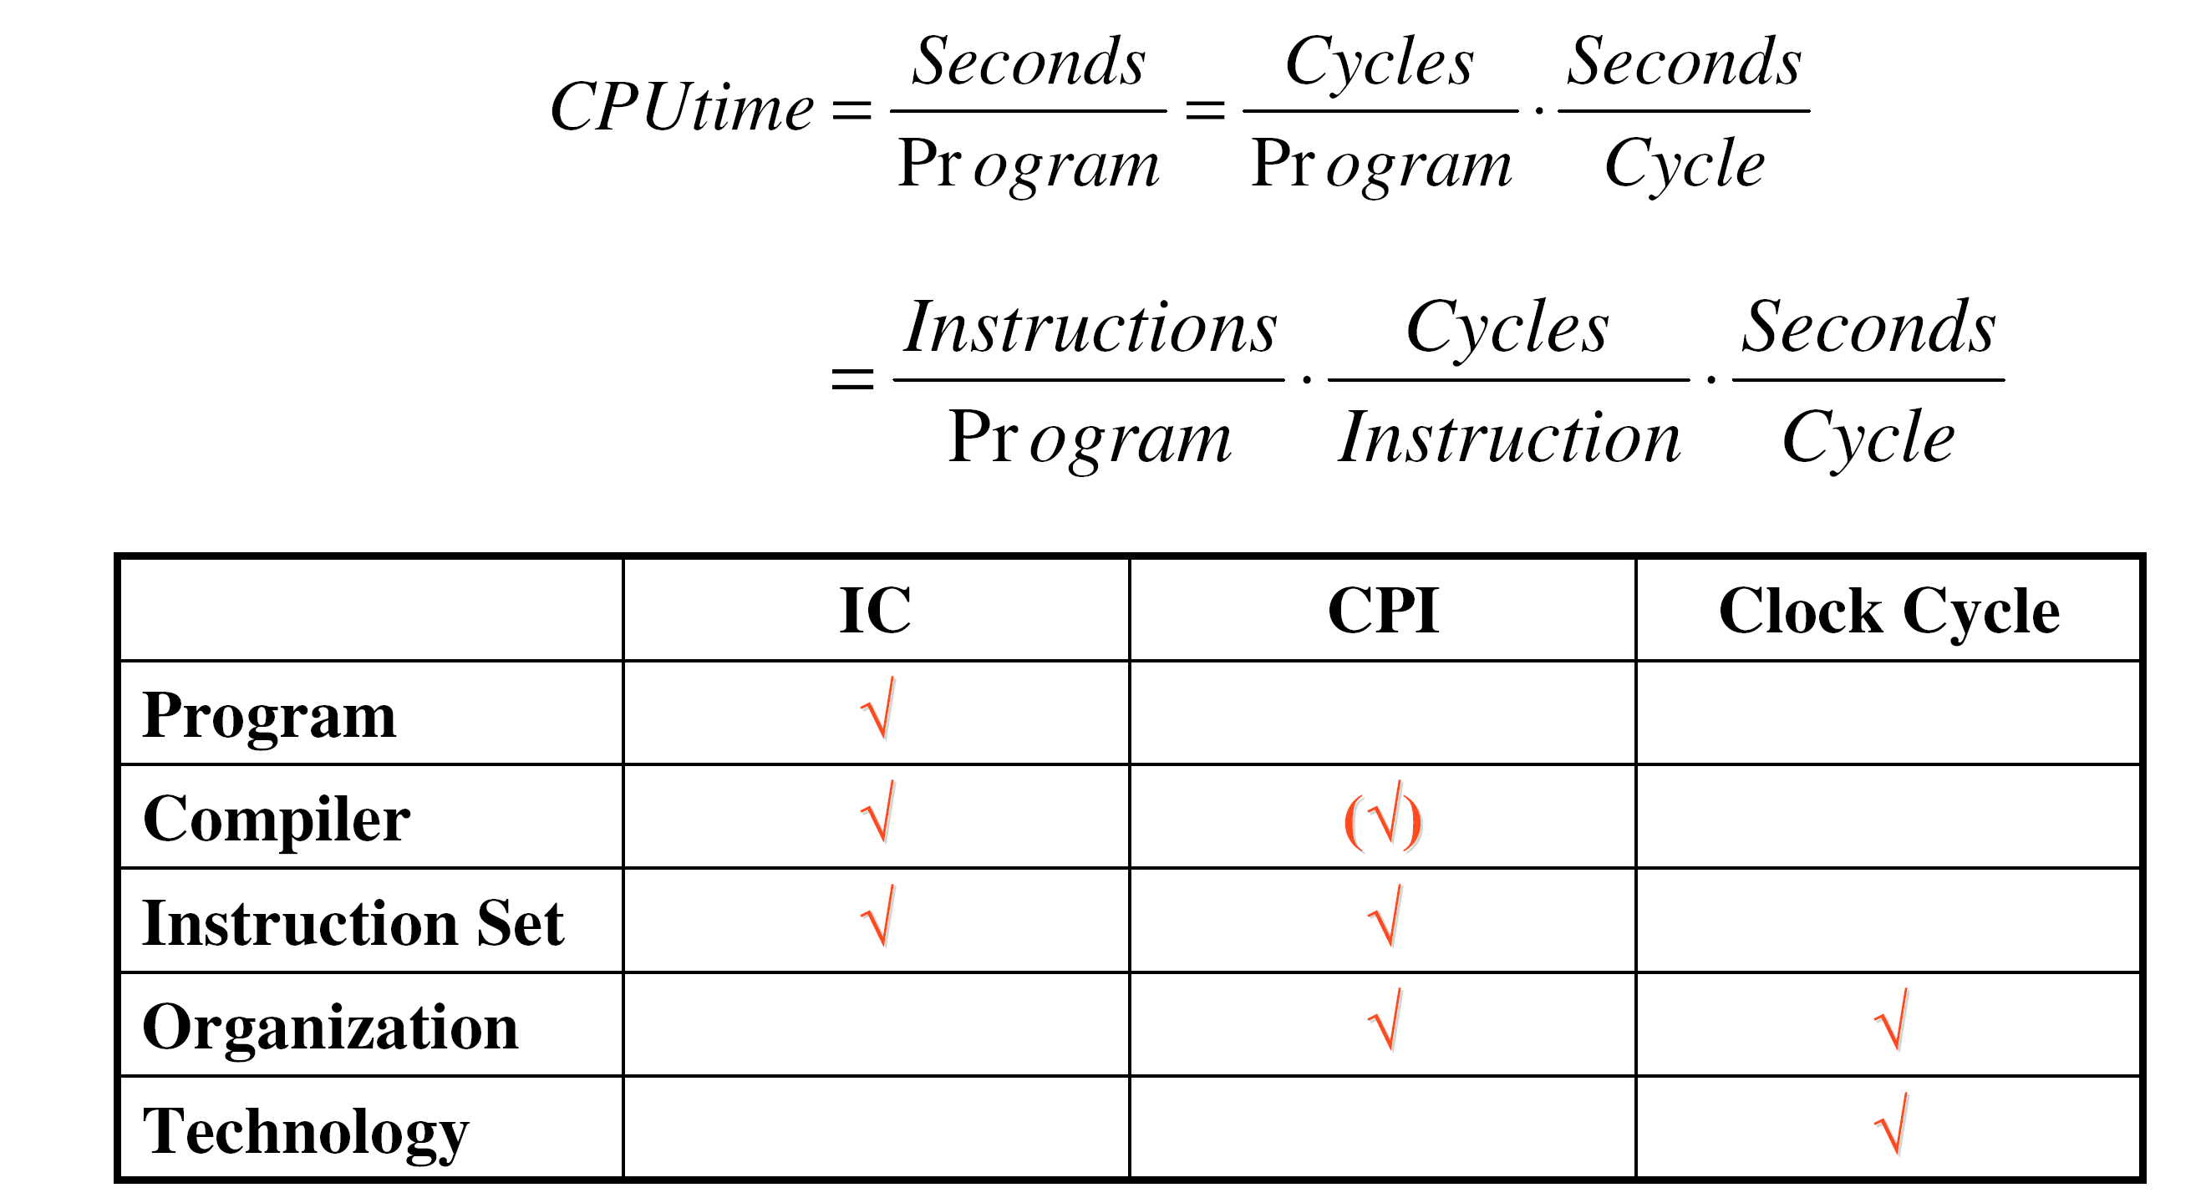
CPU Performance
CPU time for program_{X,P} = Instructions executed_{P} * CPI_{X,P} * Clock cycle time_{X}
=cpu clock cycle for program_{X,P} * Clock cycle time_{X}
CPI
Inst. Count
Cycle Time
Notes:
P Program length
X Any processor

Slide 28
Example 4
Let assume that a benchmark has 100 instructions:
25 instructions are loads/stores (each take 2 cycles)
50 instructions are adds (each takes 1 cycle)
25 instructions are square root (each takes 50 cycles)
What is the CPI for this benchmark?

Slide 29
Example 4
Let assume that a benchmark has 100 instructions:
25 instructions are loads/stores (each take 2 cycles)
50 instructions are adds (each takes 1 cycle)
25 instructions are square root (each takes 50 cycles)
What is the CPI for this benchmark?
CPI = ((0.25 * 2) + (0.50 * 1) + (0.25 * 50)) = 13.5

Slide 30
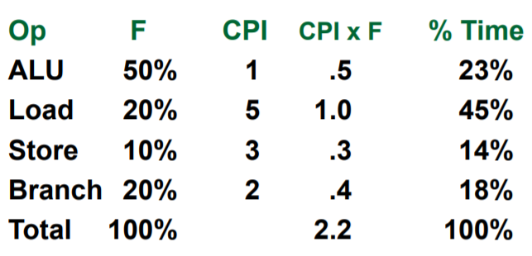
Computing CPI
The CPI is the average number of cycles per instruction
If for each instruction type, we know its frequency and number of cycles need to execute it, we can compute the overall CPI as follows
CPI = Σ CPI x F
For example

Slide 31
Cycles Per Instruction (Throughput)
CPU time_{X,P} = Instructions executed_{P} * CPI_{X,P} * Clock cycle time_{X}
“Cycles per Instruction”
CPI = (CPU Time * Clock Rate) / Instruction Count
= CPU clock Cycles / Instruction Count

Slide 32
Example 5
Suppose we have two implementations of the same ISA
For some program,
Machine A has a clock cycle time of 10 ns. and a CPI of 2.0
Machine B has a clock cycle time of 20 ns. and a CPI of 1.2
Which machine is faster for this program, and by how much?
Assume that # of instructions in the program is 1,000,000,000

Slide 33
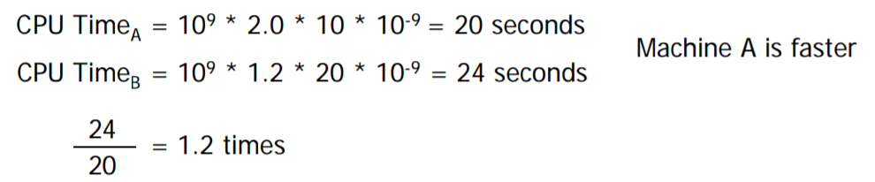
Example 5
Suppose we have two implementations of the same ISA
For some program,
Machine A has a clock cycle time of 10 ns. and a CPI of 2.0
Machine B has a clock cycle time of 20 ns. and a CPI of 1.2
Which machine is faster for this program, and by how much?
Assume that # of instructions in the program is 1,000,000,000

Slide 34
Principal Design Metrics: CPI and Cycle Time

Slide 35
Example 6
Typical Mix
Op Freq Cycles CPI
ALU 50% 1 .5
Load 20% 5 1.0
Store 10% 3 .3
Branch 20% 2 .4
2.2

Slide 36
Example 6
Typical Mix
Op Freq Cycles CPI
ALU 50% 1 .5
Load 20% 5 1.0
Store 10% 3 .3
Branch 20% 2 .4
2.2
How much faster would the machine be if a better data cache reduced the average load time to 2 cycles?
Load → 20% x 2 cycles = .4
Total CPI 2.2 → 1.6
Relative performance is 2.2 / 1.6 = 1.38
How does this compare with reducing the branch instruction to 1 cycle?
Branch → 20% x 1 cycle = .2
Total CPI 2.2 → 2.0
Relative performance is 2.2 / 2.0 = 1.1

Slide 37
Example 7
A compiler designer is trying to decide between two code sequences for a particular machine. Based on the hardware implementation, there are three different classes of instructions: Class A, Class B, and Class C, and they require one, two, and three cycles (respectively)
The first code sequence has 5 instructions: 2 of A, 1 of B, and 2 of C
The second sequence has 6 instructions: 4 of A, 1 of B, and 1 of C
Which sequence will be faster? How much?
What is the CPI for each sequence?

Slide 38
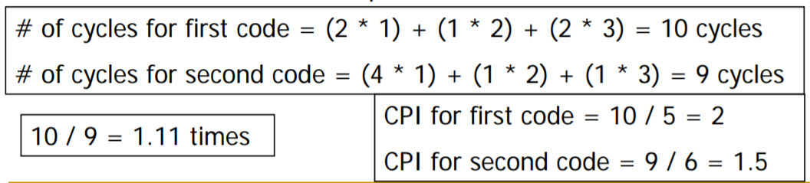
Example 7
A compiler designer is trying to decide between two code sequences for a particular machine. Based on the hardware implementation, there are three different classes of instructions: Class A, Class B, and Class C, and they require one, two, and three cycles (respectively)
The first code sequence has 5 instructions: 2 of A, 1 of B, and 2 of C
The second sequence has 6 instructions: 4 of A, 1 of B, and 1 of C
Which sequence will be faster? How much?
What is the CPI for each sequence?

Slide 39
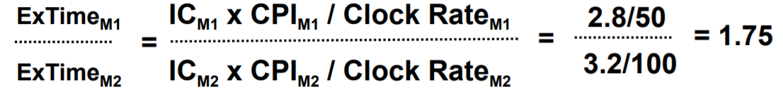
Example 8
Computers M1 and M2 are two implementations of the same instruction set
M1 has a clock rate of 50 MHz and M2 has a clock rate of 100 MHz
M1 has a CPI of 2.8 and M2 has a CPI of 3.2 for a given program
How many times faster is M2 than M1 for this program?

Slide 40
Summary: Evaluating Instruction Sets and Implementation
Design-time metrics:
Can it be implemented, in how long, at what cost?
Can it be programmed? Ease of compilation?
Static Metrics:
How many bytes does the program occupy in memory?
Dynamic Metrics:
How many instructions are executed?
How many bytes does the processor fetch to execute the program?
How many clocks are required per instruction?
How "lean" a clock is practical?
Best Metric: Time to execute the program!
CPI
NOTE: Depends on instructions set, processor organization, and compilation techniques.
Inst. Count
Cycle Time

Slide 42
Amdahl’s Law
Amdahl’s Law states that optimizations are limited in their effectiveness.
For example, doubling the speed of floating-point operations sounds like a great idea. But if only 10% of the program execution time T involves floating-point code, then the overall performance improves by just 5%.
What is the maximum speedup from improving floating point?
CPU Execution time after improvement | = | Time affected by improvement | + | Time unaffected by improvement
 |  | Amount of improvement
Execution time after improvement | = | 0.10 T | + | 0.90 T | = | 0.95 T
 |  | 2
Second Law of Performance:
Make the fast case common

Slide 43
Example 9
Assume that a program runs in 100 seconds on a machine, with multiply operations responsible for 80 seconds. How much do I have to improve the speed of multiplication if I want my program to run 2 times faster?

Slide 44
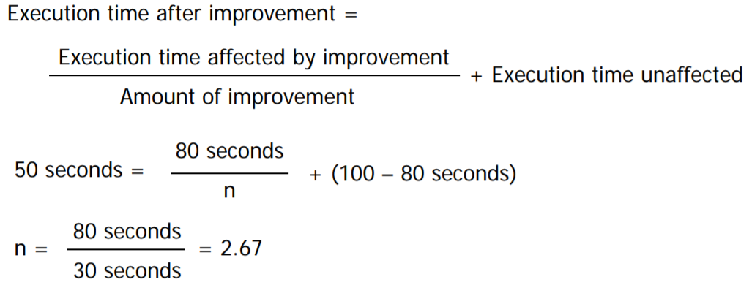
Example 9
Assume that a program runs in 100 seconds on a machine, with multiply operations responsible for 80 seconds. How much do I have to improve the speed of multiplication if I want my program to run 2 times faster?

Slide 46
Marketing Metrics
MIPS = Instruction Count / ExecutionTime * 10^6
MFLOP/s= FP Operations / Time * 10^6

Slide 47
Marketing Metrics
MIPS = Instruction Count / ExecutionTime * 10^6 = Clock Rate / CPI * 10^6

